Slide 1
Image Formation
Geometric Primitives and Transformation, Photometric Image Formation, Principle of Digital Camera
Computer Vision, 6th Semester, 2024

Slide 2
Geometric Primitives and Transformation

Slide 3
Geometric Primitives
2D concepts of Image
Points/Pixels
Lines
Conics
3D concepts of Image
Points
Lines
Planes
Quadrics

Slide 4

2D concepts of Images
Cartesian Coordinates:
Homogeneous Coordinates:
Lines:
Conic surfaces:

Slide 5
3D concepts of Images
Cartesian Coordinates:
Homogeneous Coordinates:
Lines from two points p and q:
Planes:
Conic surfaces:

Slide 6
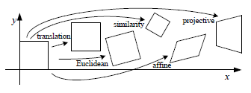
Geometric Transformations

Slide 7
2D Geometric Transformations
Rotation + Translation (Euclidean transform)
Translation
Rotation
Combination
Scaling
Similarity transform (scaled rotation)
Reflection (special case of Euclidean)
Affine Transformation
Shearing or stretching/squashing
Projective Transformation (Homography)

Slide 8
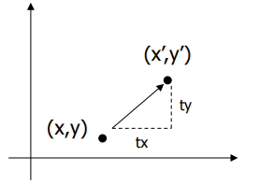
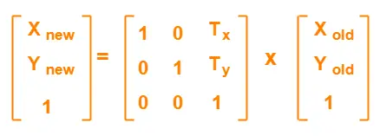
2D Translation

Slide 9
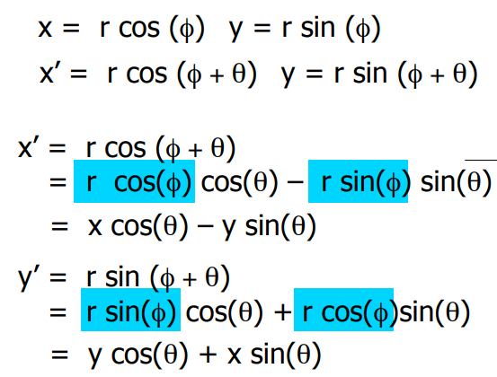
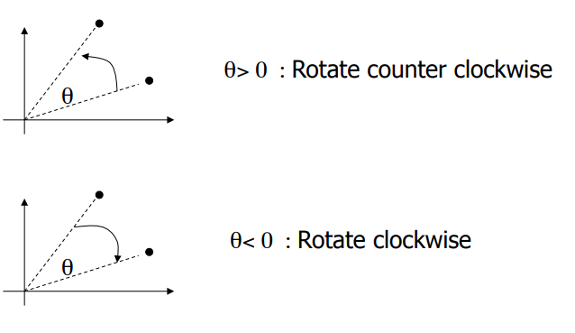
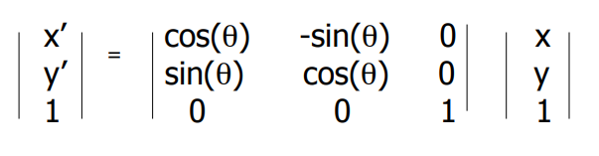
2D Rotation

Slide 10

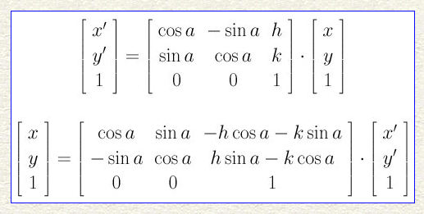
2D Euclidean Transform (Rotation + Translation)

Slide 11
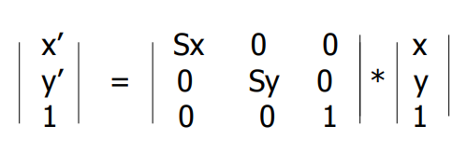
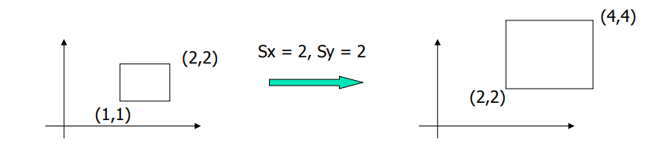
2D Scaling

Slide 12

2D Similarity Transform (scaled rotation)

Slide 13
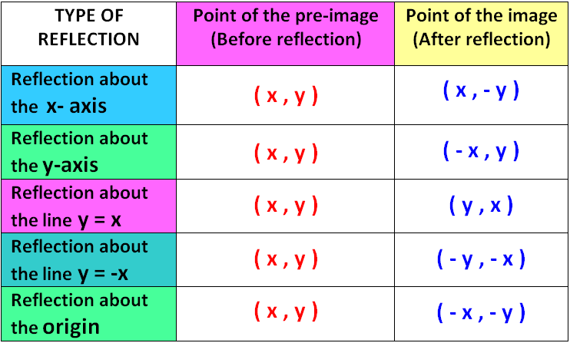
2D Reflection

Slide 14
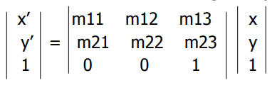
2D Affine Transformation

Slide 15

2D Projective / Perspective Transformation (Homography)

Slide 16
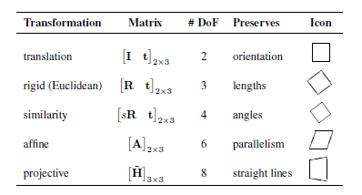
Comparison of 2D transformations

Slide 17
3D Geometric Transformations (similar to 2D transformations)
Rotation + Translation (Euclidean transform)
Translation
Rotation
Combination
Scaled Rotation (similarity transform)
Affine Transformation
Projective Transformation (Homography)

Slide 18
Photometric Image Formation

Slide 19
Lighting and Reflectance
Image – 2D function of coordinates (x, y) as:
f(x, y) = I(x, y) * R(x, y)
I(x, y) = intensity of light incident on the pixel surface
R(x, y) = reflectivity of pixel surface
Real 2D images are generated when light reflecting from various surfaces is captured by sensors
Note: Computer graphics deals with mathematically modeled generation of synthetic images

Slide 20
Lighting and Reflectance
Lighting: required to show realistic effect of 3D objects in a 2D image
Simply color-filling the surfaces gives a flat shading and no realism or 3D effect/information
Reflected light scattered from object surface depends on:
reflecting surface
incident light

Slide 21
Light Sources
Point Source:
Originate at single source in space, potentially at infinity w.r.t. object surface
Intensity + Color spectrum
E.g. Small light bulb, Sun
Area Source:
Planar source at finite distance
E.g. Fluorescent ceiling lamp, LED panel

Slide 22

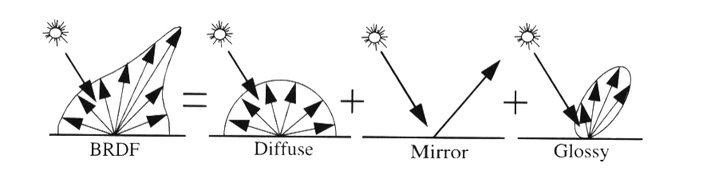
Bi-directional Reflectance Distribution Function (BRDF)

Slide 23
Illumination/Reflection models
Diffuse Illumination/Reflection
Comes from one direction; scattered in all directions
Specular Illumination/Reflection
Comes from one direction; scattered in a preferred direction
Ambient Illumination/Reflection
Comes from all directions; scattered in all directions

Slide 24
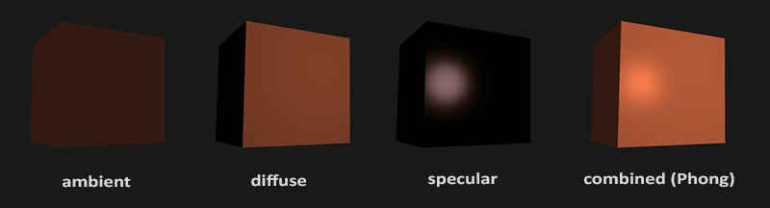
Illumination models

Slide 25
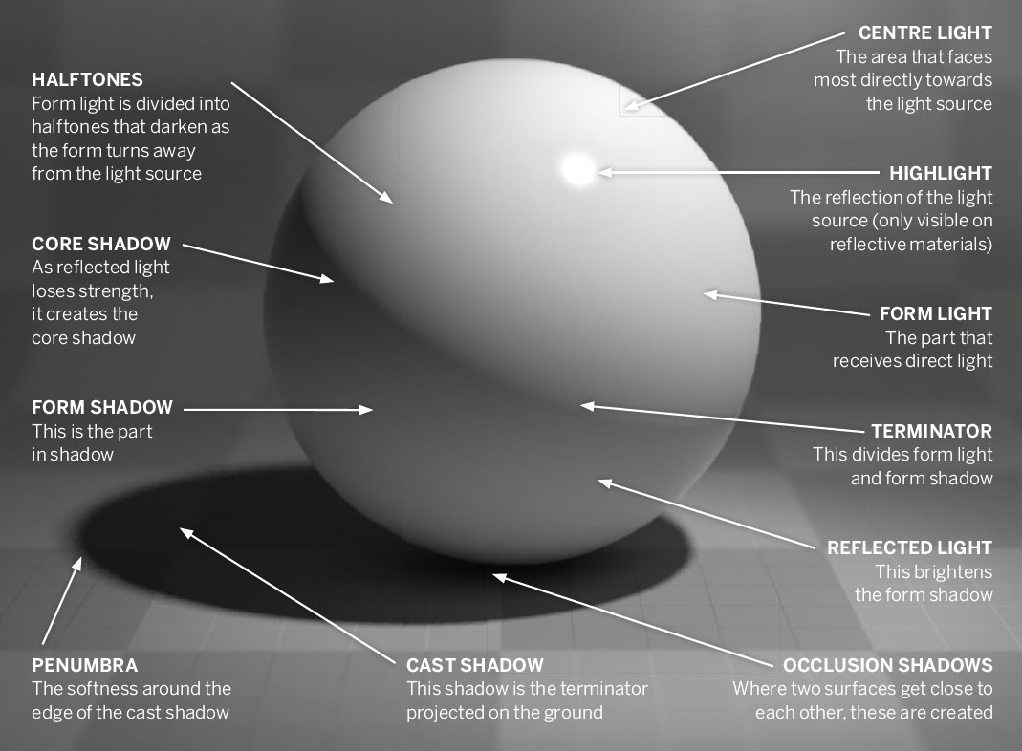
Illumination of an object

Slide 26
Surface Rendering models
Constant Intensity (Flat) Rendering
Gourard Rendering
Phong Shading

Slide 27
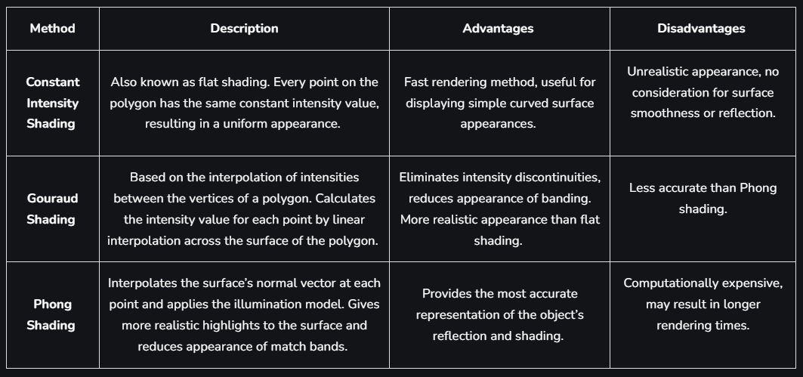
Surface rendering

Slide 28
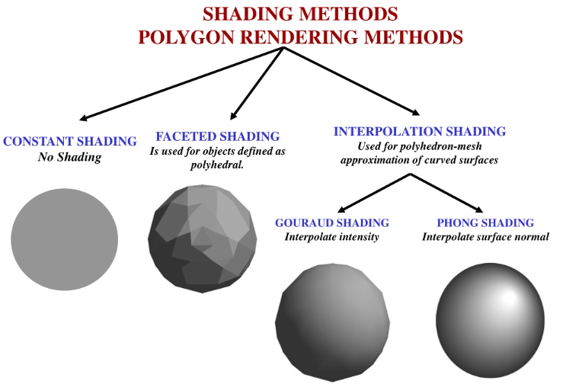
Surface Rendering

Slide 29
Global Illumination
Ray Tracing | Radiosity
Associate a light ray with each pixel in the camera image Find the intersection with the nearest surface Shading equation used to find out ‘primary illumination contribution’ Alternative: shadow map/buffer (render the scene from the light source perspective, then render pixel depths as per the map Great specular lighting; approximated diffuse lighting; view-dependent illumination | Associate illumination values with rectangular surface areas in the scene Form factor computer (depends on orientation and surface reflectance) Does not consider ‘near field effects’ like darkening inside corners and scratches Simulate the many reflections of light around a scene Softer natural shadows and reflections Great diffuse lighting; specular lighting ignored; view-dependent illumination of mostly enclosed areas

Slide 30
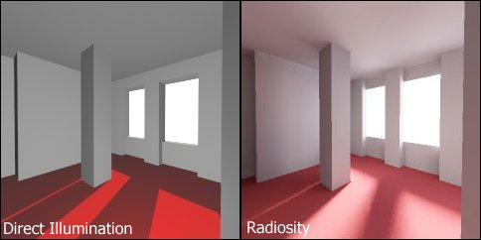
Ray Tracing vs Radiosity

Slide 31
Principle of Digital Camera

Slide 32
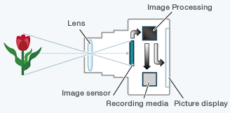
Image Acquisition via Digital Camera
Light entering through the lens strikes an image sensor.
The signal output by the image sensor is processed within the camera to create image data, which is stored on the memory card.
The image can be simultaneously viewed on the picture display.

Slide 33
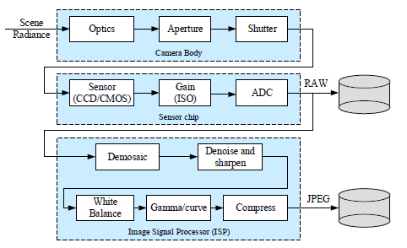
Digital Image Acquisition process

Slide 34
CCD vs CMOS
Name | Charge-Coupled Device (CCD) | Complementary Metal Oxide semiconductor (CMOS)
Cost | More expensive | Cheaper
Shutter Type | Global (exposes the entire image simultaneously, but can cause motion blur, which is mitigated by high shutter speed) | Rolling (expose different parts of the frame at different points in time)
Skew | No | Yes
Wobble | No | Yes
Partial Exposure | No | Yes
Vertical Smear (undesired signal that appears as a brighter vertical (from top to bottom) stripe emanating from a bright part of the image) | Yes | No
Noise | Less | More
Power Efficiency | Less | More

Slide 35
Factors affecting sensor performance
Shutter speed
Controls amount of light reaching the sensor (under or over exposure)
Also determines motion blur
Sampling pitch
Physical spacing between adjacent sensor cells on the imaging chip
Smaller pitch = higher density = higher resolution = less light-sensitive (less area) and more noise-prone
Fill factor
Ratio of active sensing area to theoretically available sensing area
Higher fill factor preferable (more light capture and less aliasing)
Chip size
Larger size preferable for higher photo-sensitivity
But larger chips are more expensive to produce (fewer chips per wafer; higher probability of chip defect)
Analog gain
ISO setting for exposure control
Higher gain = better low-light performance but higher sensor noise
Sensor noise
Fixed pattern noise
Dark current noise
Shot noise
Amplifier noise
Quantization noise, etc.
Noise models are calculated and necessary for various CV algorithms
Resolution and quality of the analog-to-digital converter (ADC)

Slide 36
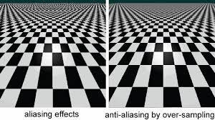
Sampling and Aliasing
Aliasing occurs when a signal is sampled at a less than twice the highest frequency present in the signal.
Signals at frequencies above half the sampling rate must be filtered out to avoid the creation of signals at frequencies not present in the original signal.
Anti-aliasing is a process which attempts to minimize the appearance of aliased diagonal edges.
Anti-aliasing gives the appearance of smoother edges and higher resolution by taking into account how much an ideal edge overlaps adjacent pixels.

Slide 37
Color Models and Spaces
RGB
HSV
HSI
YUV and YIQ
Y-Cb-Cr
L*a*b*
CMYK

Slide 38
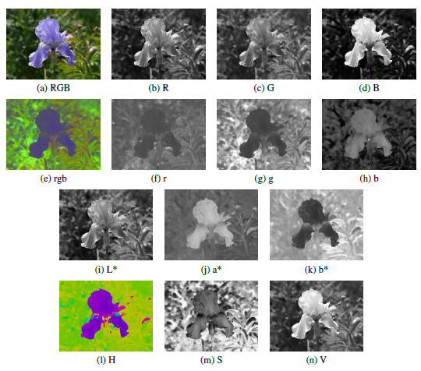
Color Models and Spaces
Figures (a) – (d): RGB space
Figures (e) – (h): rgb Ratio space
Figures (i) – (k): L*a*b* space
Figures (l) – (n): HSV space

Slide 39
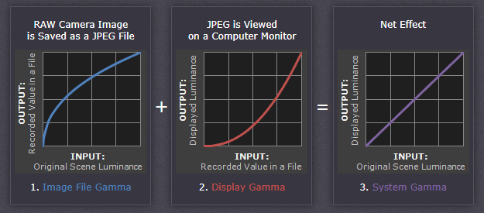
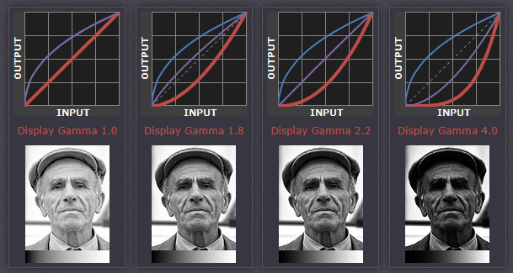
Gamma Correction
When you map intensity values from one range to another, you can optionally perform a nonlinear mapping using gamma correction. The gamma correction factor can be any value between 0 and infinity.
When gamma is less than 1, the mapping is weighted toward higher (brighter) output values.
When gamma is greater than 1, the mapping is weighted toward lower (darker) output values.
When gamma is exactly 1, the mapping is linear.
Gamma correction is commonly performed with the Power Law transform.
More reading:
https://www.cambridgeincolour.com/tutorials/gamma-correction.htm

Slide 40
Compression
Lossless
RAW
PNG
Lossy
JPEG
JPEG 2000
JPEG XR
AVI
Motion JPEG (MPEG)

